Slide 1
We are learning about atomic structure
TRACK WITH ME
READ WITH ME
Students will be able to:
Draw and label the structure of an atom
Determine the number of protons, neutrons and electrons in an element
Classify substances as elements, compounds, and mixtures.

Slide 2
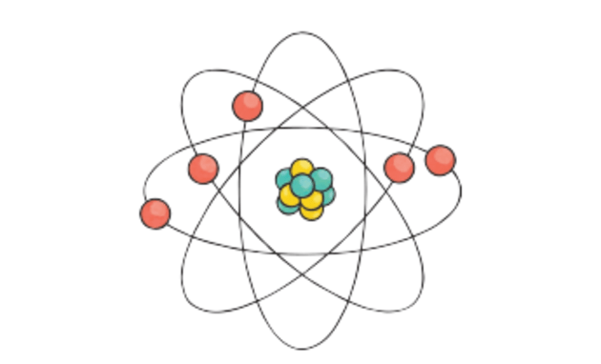
Repeat the opposite word/phrase.
ATOM
THE SMALLEST PARTICLE OF A CHEMICAL ELEMENT THAT CAN EXIST.

Slide 3
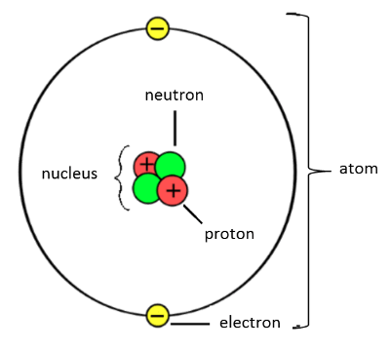
The structure of an atom
An atom is made up of protons, neutrons and electrons.
Protons and neutrons make up the nucleus which is at the centre of the atom.
Electrons are found in shells (or orbitals)around the outside of the nucleus.

Slide 4
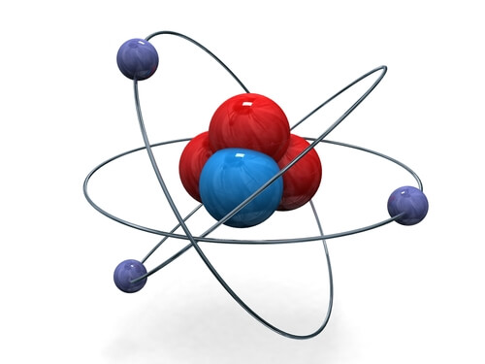
The structure of an atom
Atoms are made up of three subatomic particles: protons, neutrons and electrons.
The nucleus (centre) of an atom is made up of protons and neutrons.
The electrons orbit around the outside of the nucleus in shells.

Slide 5
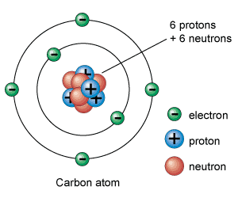
Charges!
A proton has a positive charge
A neutron has no charge
An electron has a negative charge

Slide 6
Charges!
A proton has a positive charge
A neutron has no charge
An electron has a negative charge

Slide 7
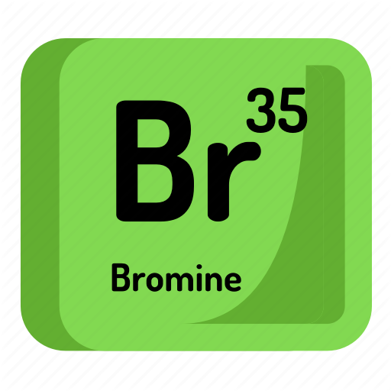
Repeat the opposite word/phrase.
ELEMENT
A SUBSTANCE THAT CONTAINS ONLY ONE TYPE OF ATOM

Slide 8
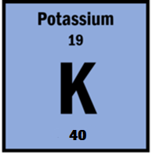
Repeat the opposite word/phrase.
ATOMIC NUMBER
THE NUMBER OF PROTONS IN AN ATOM

Slide 9
Repeat the opposite word/phrase.
MASS NUMBER
THE NUMBER OF PROTONS AND NEUTRONS IN AN ATOM

Slide 10
Atomic Number and Mass Number
The atomic number at the top of the periodic table tells you the number of protons in an atom. This also tells you the number of electrons in an element.
The Mass number at the bottom of the element tells you the number of protons + neutrons.
To work out neutrons you need to subtract the atomic number from the mass number

Slide 11

Calculating the number of neutrons
40 – 19 = 21 neutrons

Slide 12
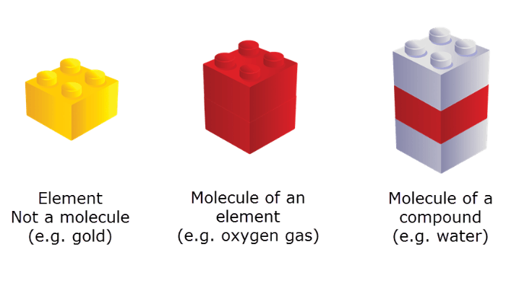
Elements, Compounds and Mixtures
An element is a substance containing only one type of atom. For example, elemental copper contains only copper atoms.
A compound is a substance containing at least two different types of atom that are chemically combined. Compounds can be molecules (such as H_{2​}O) or lattices (such as Al_{2​}O₃​).
A mixture is a substance containing two or more different types of atom that are NOT chemically combined. For example, air consists of many different gases like hydrogen, helium, oxygen and argon.

Slide 13
Elements, Compounds and Mixtures
A mixture is a substance containing two or more different types of atom that are NOT chemically combined.
An element is a substance containing only one type of atom.
A compound is a substance containing at least two different types of atom that are chemically combined.

Slide 14
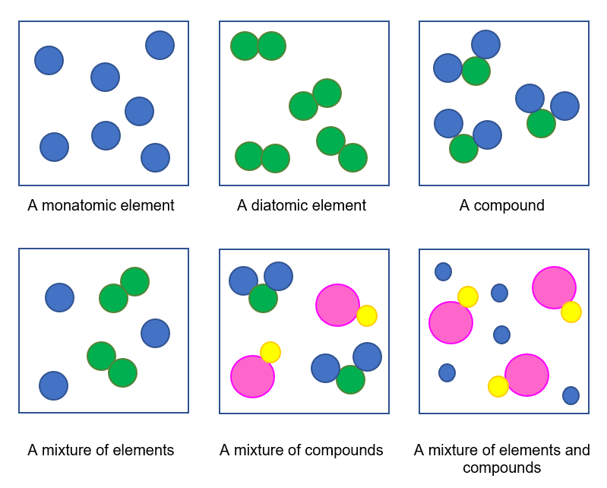
Particle diagrams
Atoms of the same element in diagrams will be drawn as the same size and they will be the same colour.
If the atoms are of different elements, they will be a different colour and possibly a different size.

Slide 15
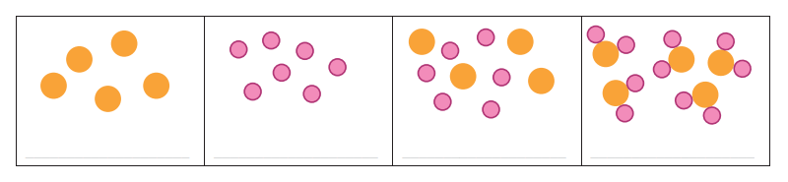
Element, Compound or Mixture?
TEACHER CUE
CFU
What does each box represent?
An element, a compound or a mixture?
1
2
3
4

Slide 16
We are learning about atomic structure
TRACK WITH ME
READ WITH ME
Students will be able to:
Draw and label the structure of an atom
Determine the number of protons, neutrons and electrons in an element
Classify substances as elements, compounds, and mixtures.

